Slide 1

The Battle of Neighborhoods- Open a Japanese Restaurant in New York City

Slide 2
Introduction
As one of the world's leading metropolises for art, fashion, food and theater, New York city attracts a large number of tourists and immigrants. It brings in a variety of people from different ethnic backgrounds. As the hub of interactions between multiple cultures, New York city has many opportunities for entrepreneurs to start or grow their business. New York city is also well-known as a 'food paradise', there are many restaurants in New York City, each belonging to different categories like Chinese, Japanese, Thailand, etc. so opening a restaurant seems to have a promising future.
In this project, I am going to look for an optimal location to open a Japanese restaurant for a successful business. There are two aspects that I would mainly consider. The first factor is the extent of competition among Japanese restaurants in different places. The other concern is the popularity of the location, such as whether the place has high average ratings, which is more likely to appeal to more people visiting. the report can provide a reference for following audience: a) people who desire to open a Japanese restaurant in New York city; b) Business man who want to invest in Japanese restaurant in New York city; c) visitors or immigrants who are big fan of Japanese cuisine.

Slide 3
Data
The following data is necessary for this project:
a) New York City data that contains Borough, Neighborhoods along with the latitudes and longitudes
Data Source: https://cocl.us/new_york_dataset
Description: This data set is used to to explore various neighborhoods of new york city.
b) Japanese restaurants in Queens neighborhood of new york city.
Data Source: Foursquare API
Description: Foursquare data is very comprehensive and it powers location data,from which we can get details such as latitudes and longtitudes,etc.
c) New York City data containing neighborhood boundaries
Data source: https://data.cityofnewyork.us/City-Government/Borough-Boundaries/tqmj-j8zm

Slide 4
Methodology
a) Data will be collected from https://cocl.us/new_york_dataset and cleaned and processed into a dataframe.
b) FourSquare be used to locate all venues and then filtered by Italian restaurants. Ratings, tips, and likes by users will be counted and added to the dataframe.
c) Data will be sorted based on rankings
d) Data will be visually assessed using graphing from various Python libraries.

Slide 5
Problem Statement
a) What is / are the best location(s) for Japanese cuisine in New York City? In what Neighborhood and/or borough should I open a Japanese restaurant to have the best chance of being successful?
b) Where would tourists or any Japanese food fans go in New York City to have the best Japanese food? or say which place is more popular among those Japanese food fans?

Slide 6
Problem Statement
a) What is / are the best location(s) for Japanese cuisine in New York City? In what Neighborhood and/or borough should I open a Japanese restaurant to have the best chance of being successful?
b) Where would tourists or any Japanese food fans go in New York City to have the best Japanese food? or say which place is more popular among those Japanese food fans?

Slide 7
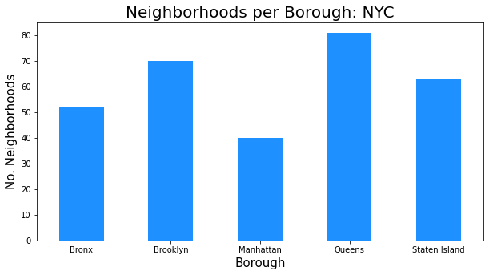
Results

Slide 8
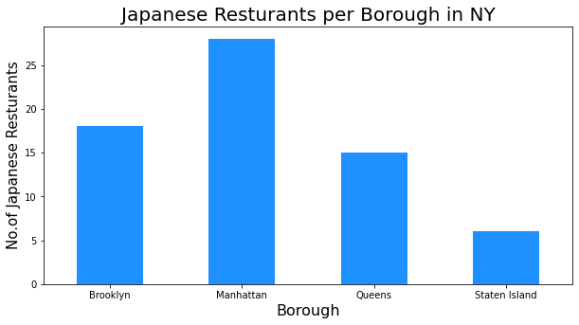

Slide 9
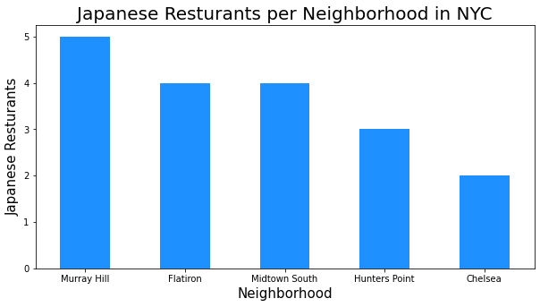

Slide 10
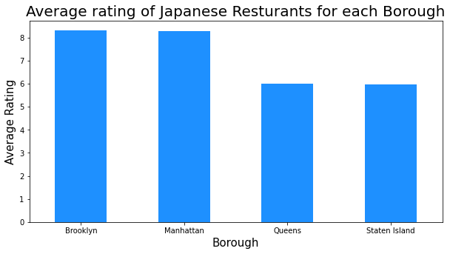

Slide 11
Discussion
Despite Manhattan having the least number of neighborhoods in all five boroughs, it has the most Japanese restaurants. It has the least number of competitors. Brooklyn and Manhattan have the highest average ratings, so it is highly likely visitors have desire to go to these two boroughs for Japanese food. Additionally, the results show that Brooklyn has the greatest number of ‘likes’, which means that people will be more likely to visit Brooklyn in search for great Japanese food. In other words, Brooklyn will be an attractive place for Japanese cuisine lovers.

Slide 12
Conclusion
Brooklyn has multiple neighborhoods with high ratings exceeding 8.0 of a scale of 1.0 to 10.0. This place has the best ratings and greatest number of likes on average, which is more likely to appeal to Japanese food fans. Visitors have higher desires to go to Brooklyn then. What makes Brooklyn a more promising market compared with Manhattan is that it has smaller number of Japanese restaurants per borough, making competition easier. Considered above factors, Brooklyn will be an optimal place to start up and invest in a Japanese restaurant.

